Slide 1
Presentation Topic : Overview of Operating System

Slide 2
Submitted to :
Khan Md. Hasib
Lecturer, Dept of CSE
State University of Bangladesh
Submitted By : Khondkar Md. Mufrat Tasif UG02-47-18-044

Slide 3
Layout
1. What is Operating System ?
2. Uses of Operating System
3. Types of Operating System
4. Important Functions of Operating System
5. Some Services of Operating System
6. Examples of Operating System

Slide 4
What is Operating System ?
An Operating System (OS) is a software that acts as an interface between computer hardware components and the user.
Every computer system must have at least one operating system to run other programs. It manages the computer's memory and processes, as well as all of its software and hardware.

Slide 5
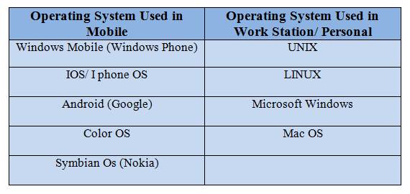
Uses of Operating System

Slide 6
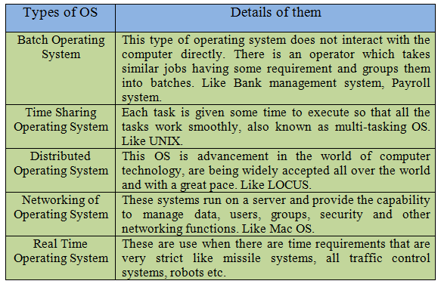
Types of Operating System

Slide 7
Important Functions of Operating System
Memory Management
Processor Management
Device Management
File Management
Job Accounting
Error Detecting Aids
Control Over System Performance
Coordination between other software and users

Slide 8
Some Services of Operating System
Program Execution
I/O Operations
Communication
Error Detection
Resource Allocation
File System Manipulation
Protection

Slide 9
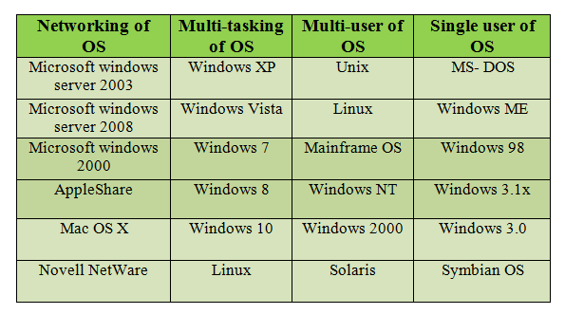
Examples of Operating Systems

Slide 10


